Slide 1

Software usage tutorial E.S.tension (email search chrome extension)
CS 410 Fall 2022 Course Project
Team members:
Yueming Pang
Yuling Gao
Schillaci Mcinnis
University of Illinois Urbana-Champaign

Slide 2
About the application
The E.S.tension is a Google Chrome extension that can parse websites and extract email addresses from them. User can navigate to any website, and just one click extension icon and all email addresses on the current website will be shown on the popup.
User also has the option to filter search results on the popup. If user provides a query word, the extension can filter out email addresses from the current page according to their relevance to the query.

Slide 3
Install the software
open terminal and direct to the directory where you want to download the extension. Use the following command to download from the GitHub:
This tutorial was performed in the Windows operating system.

Slide 4
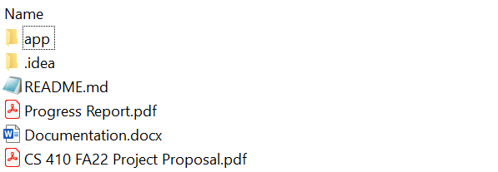
Install the software
Unzipped the file and find the “app” folder. Please ignore other files.

Slide 5
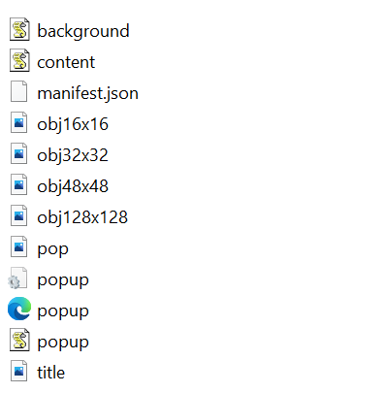
Install the software
In the “app” folder, you will find the following files:

Slide 6
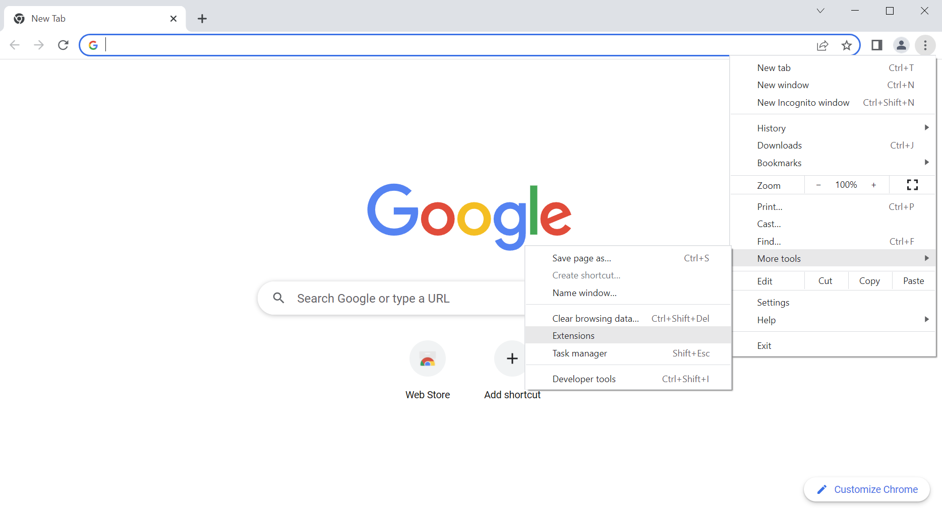
Install the software
Now open your Google Chrome and direct to the extension page:

Slide 7
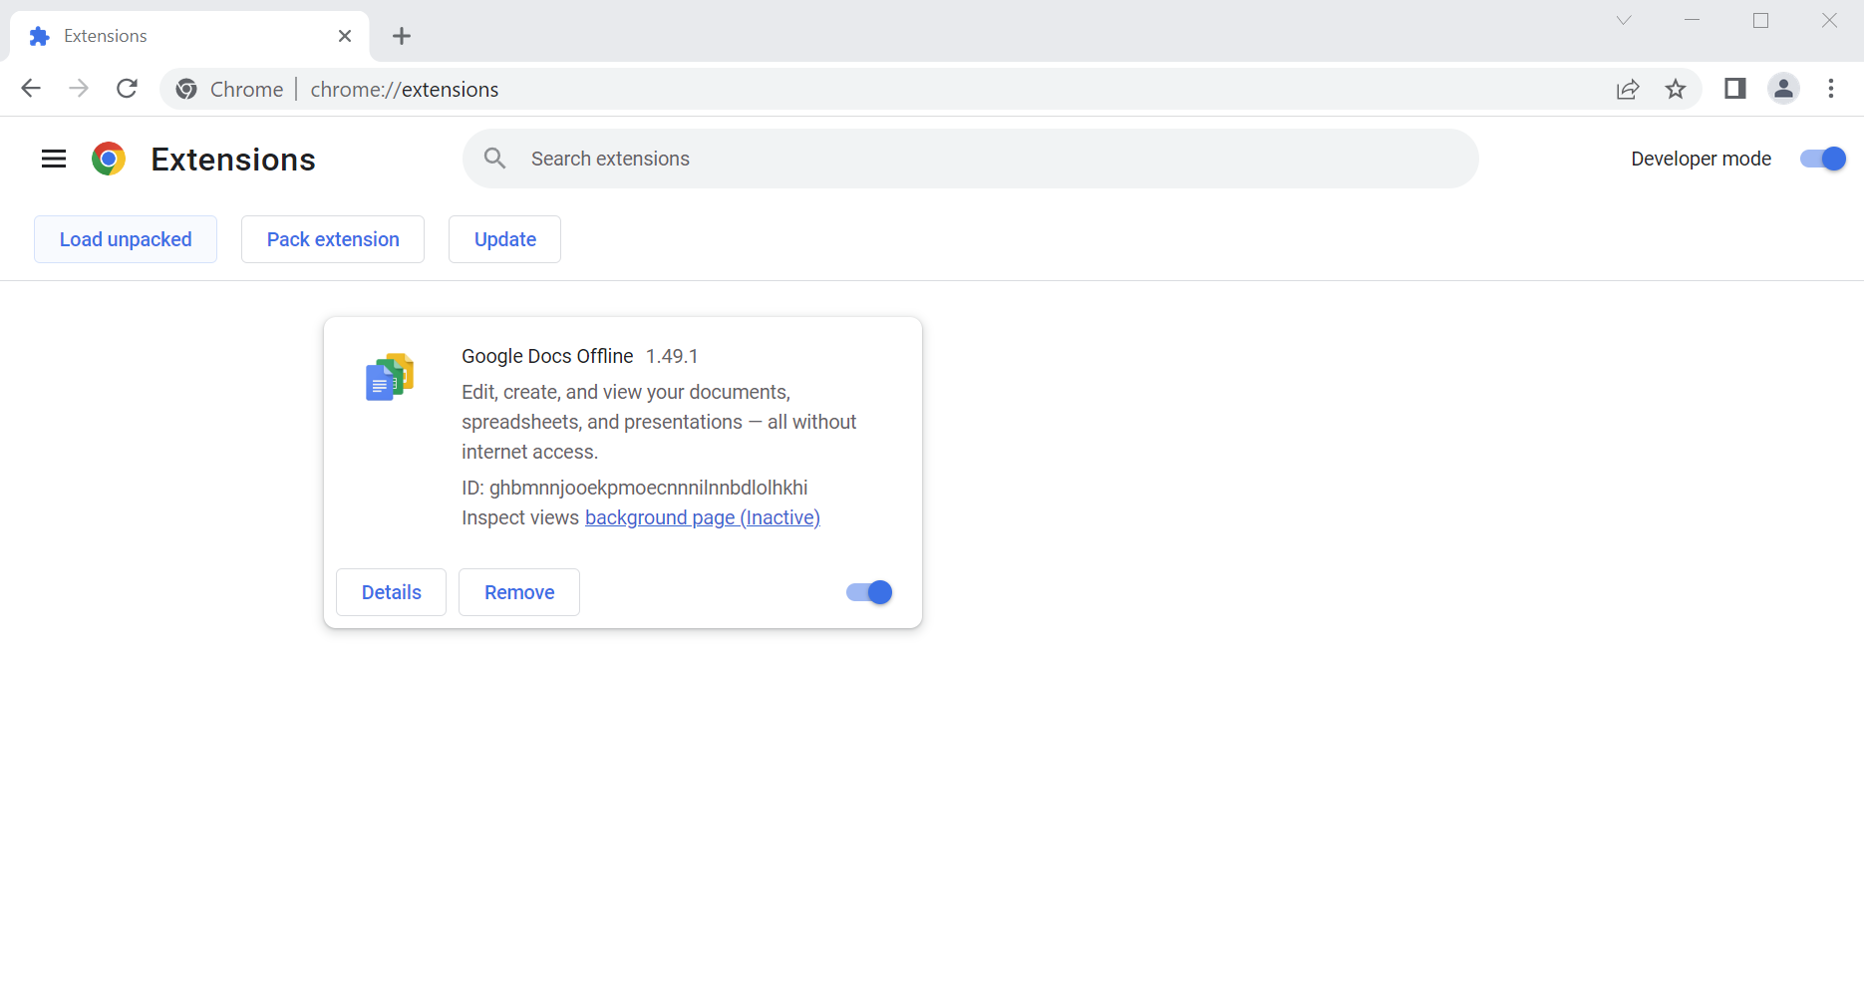
Install the software
In the extension page, enable Developer mode and Load unpacked:

Slide 8
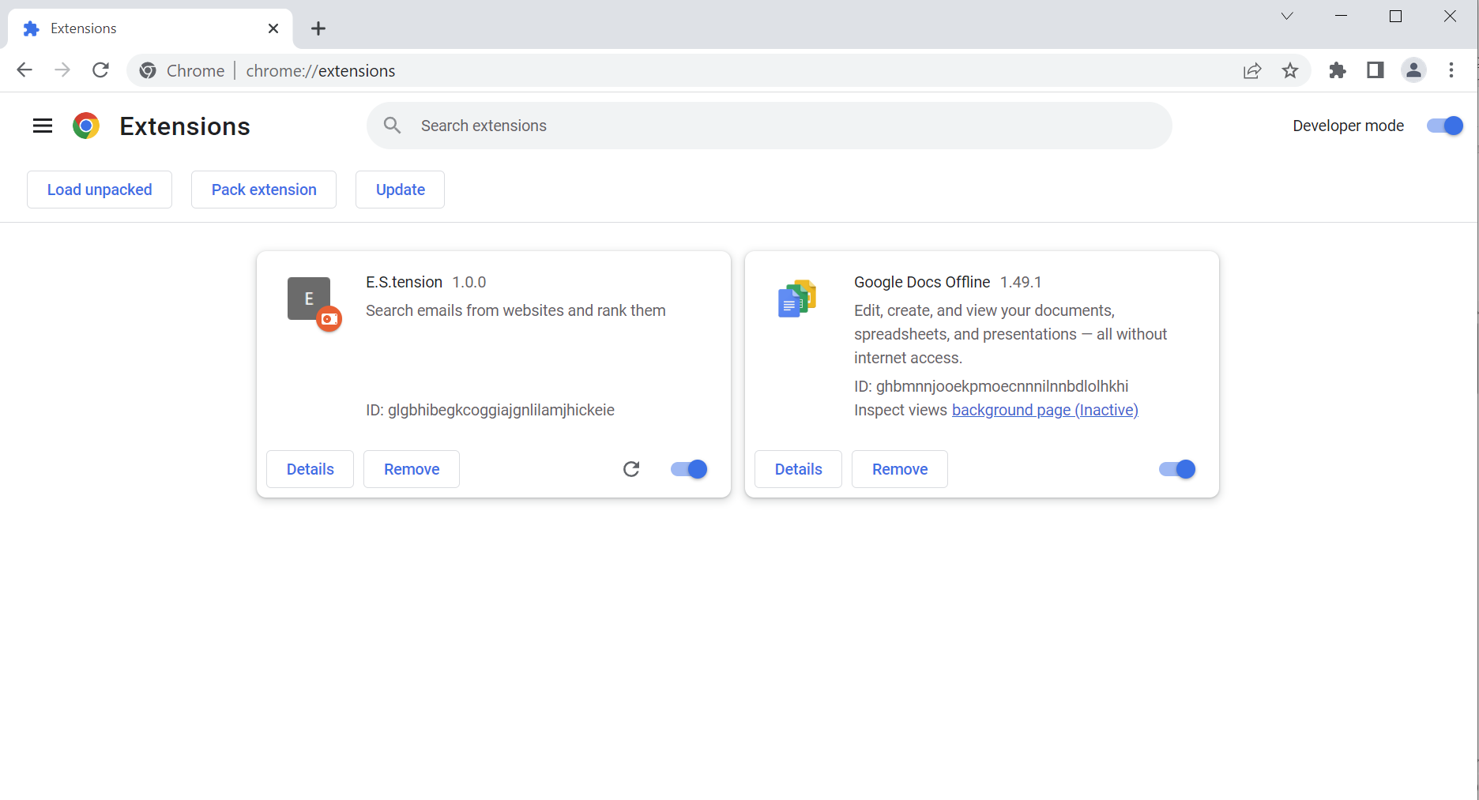
Install the software
Select the “app” folder to unpack and you will see the following:

Slide 9
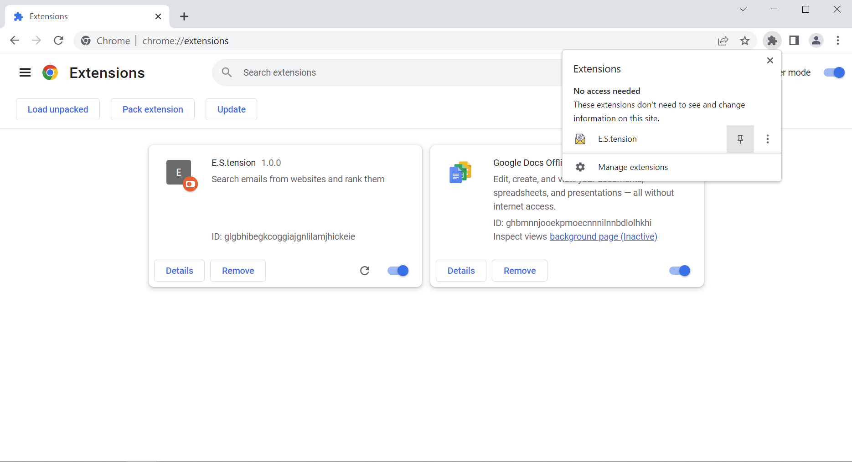
Install the software
Now you can pin the extension to your Google Chrome browser.
You can also remove it by click the Remove button:

Slide 10
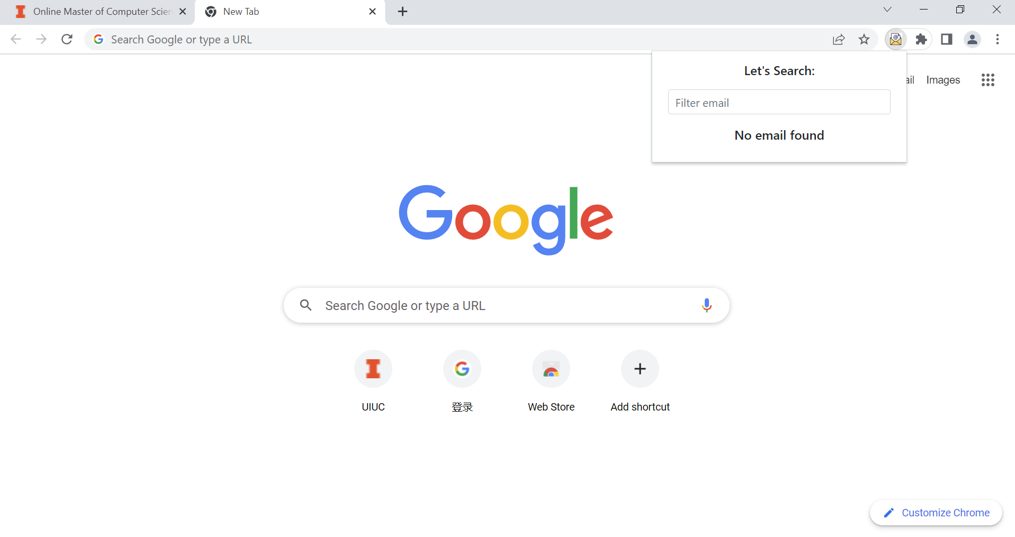
How to use the software - an example of use case
Now you have our application installed on your Google Chrome. Let’s go to a web page to try it out:

Slide 11
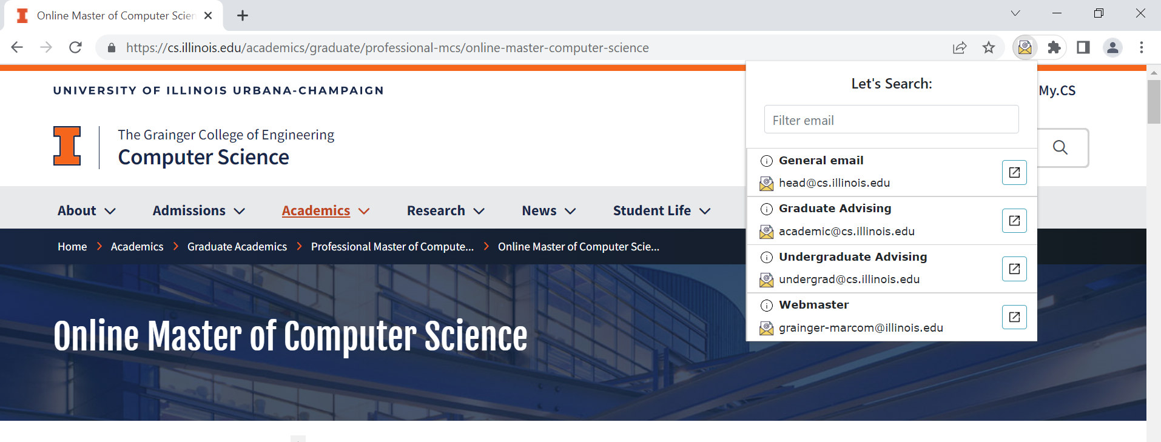
An example of use case
On this page (https://cs.illinois.edu/academics/graduate/professional-mcs/online-master-computer-science), open the popup you will see the extracted emails:

Slide 12
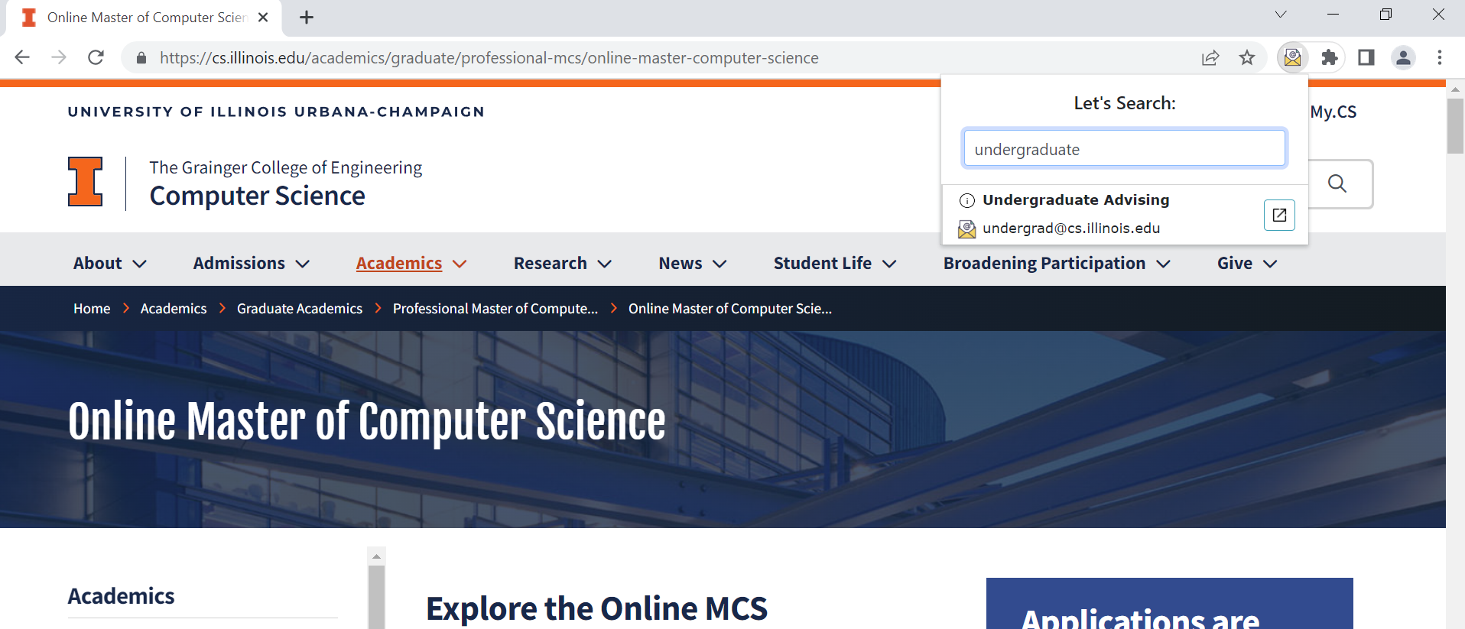
An example of use case
Now let’s enter a query word “undergraduate” and filter out the irrelevant email address:

Slide 13
An example of use case
You can also click the pop button on the right to send an email to this address:

Slide 14
Thank you!

